Slide 1
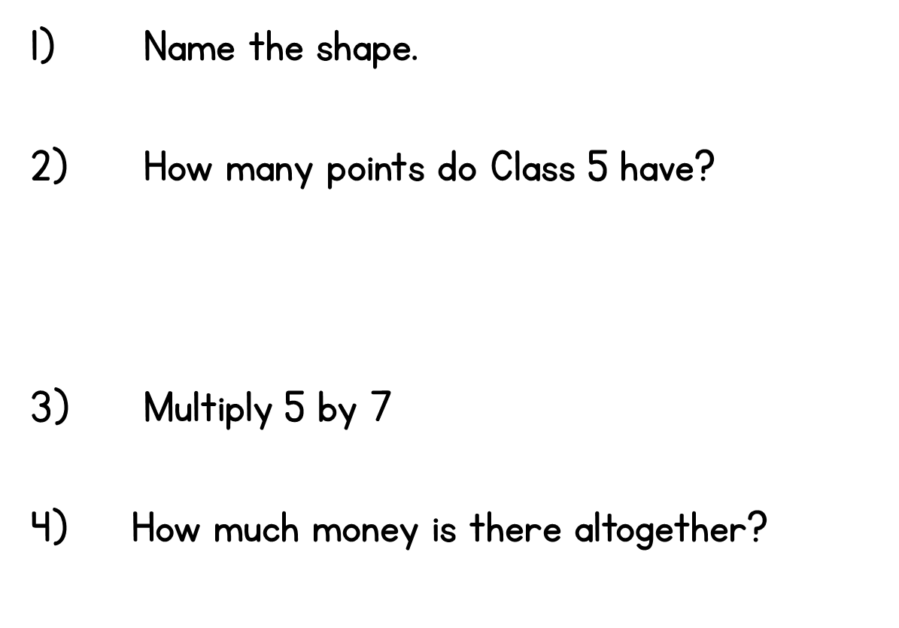
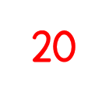
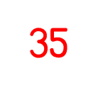
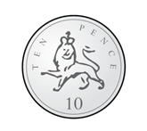
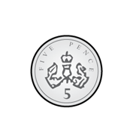
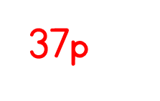
Year 2 | Week 5 | Day 1

Slide 2
Year 2 | Week 5 | Day 2

Slide 3
Year 2 | Week 5 | Day 3

Slide 4
Year 2 | Week 5 |Day 4

Slide 5
Year 2 | Week 5 |Day 5
27, 9, 35

Slide 6
Year 2 | Week 6 | Day 1

Slide 7
Year 2 | Week 6 | Day 2

Slide 8
Year 2 | Week 6 | Day 3

Slide 9
Year 2 | Week 6 | Day 4

Slide 10
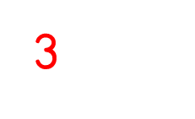
Year 2 | Week 6 | Day 5

Slide 11
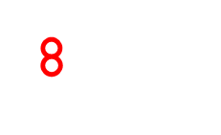
Year 2 | Week 7 | Day 1

Slide 12
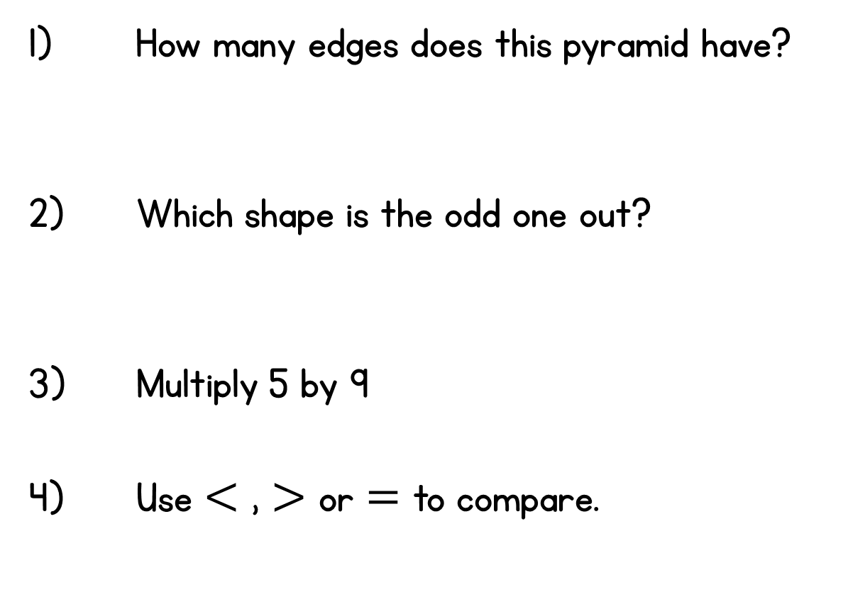
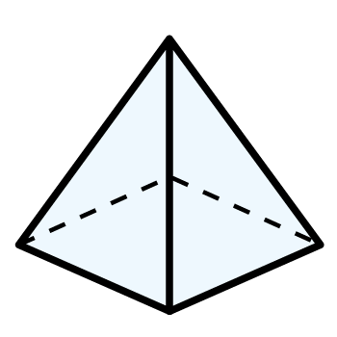
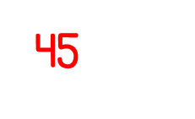
Year 2 | Week 7 | Day 2

Slide 13
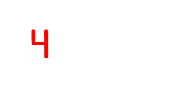
Year 2 | Week 7 | Day 3

Slide 14
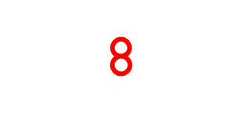
Year 2 | Week 7 | Day 4

Slide 15
Year 2 | Week 7 | Day 5

